Slide 1

The Technology Value Stream
Presented by Chelsea Hefferin

Slide 2
Brief Overview of Technology Value Stream
The Technology Value Stream refers to the series of steps and processes involved in delivering technological solutions or software—from initial concept to deployment and eventual user experience. It focuses on optimizing workflows, reducing inefficiencies, and ensuring that each step adds value to the end product, thereby maximizing efficiency and customer satisfaction.
Importance in DevOps for Delivering Value Efficiently
In DevOps, the Technology Value Stream is vital for achieving faster delivery cycles and enhancing collaboration between teams. By identifying bottlenecks and eliminating waste, DevOps practices help streamline the value stream. Automation tools and practices like CI/CD ensure shorter lead times and processing times, enabling teams to deliver value to customers in real-time while maintaining high quality. This alignment between development and operations fosters agility, innovation, and continuous improvement in software delivery.

Slide 3
Defining lead time vs. Processing time
Lead Time refers to the total time taken from the moment a customer or stakeholder makes a request until the final product or outcome is delivered. It encompasses all steps in the process, including delays, hand-offs, and waiting periods. Think of it as the customer's full experience from start to finish.
Processing Time, on the other hand, is the actual time spent actively working on fulfilling the request. This includes only the steps where value is being actively added, like coding, testing, or deploying, and excludes idle or waiting time.

Slide 4
The Common Scenario: Deployment Lead Times Requiring Months
In traditional software development processes, deployment lead times often span months, creating significant delays between feature requests and their delivery to users. These delays stem from various factors, includeing: Fragmented Workflows: Poor coordination between development, testing, and operations teams results in bottlenecks and hand off delays.
Manual Processes: Testing, approvals, and deployments are often handled manually, leading to inefficiencies and prolonged timelines.
Limited Automation: A lack of automated pipelines necessitates repetitive tasks, which further increases lead times.
Legacy Systems: Older, rigid systems slow down the pace of integration and deployment.
Extensive Review Cycles: Each phase (coding, testing, staging) demands thorough reviews, stretching the timeline.

Slide 5
Our DevOps Ideal - Deployment Lead Times of Minutes
In DevOps, the ideal scenario is achieving deployment lead times of minutes, revolutionizing how software is delivered.
Benefits of Short Deployment Lead Times:
Faster Time-to-Market: Teams can quickly adapt to customer needs and market changes, delivering updates and new features with incredible speed. Enhanced Customer Satisfaction: Rapid deployments ensure user feedback is acted upon promptly, improving the overall experience. Increased Innovation: Shorter cycles enable teams to experiment, iterate, and innovate without the fear of prolonged delays. Key Strategies to Achieve This Ideal:
Continuous Integration and Continuous Delivery (CI/CD):Automating the build, test, and deployment processes significantly reduces lead times.
Infrastructure as Code (IaC):Automating infrastructure provisioning and configuration simplifies deployment.
Cross-Functional Collaboration:Development, operations, and quality assurance teams work together seamlessly, eliminating silos and inefficiencies.
Monitoring and Feedback:Real-time monitoring tools provide insights into deployment performance. Feedback loops help teams continuously improve.

Slide 6
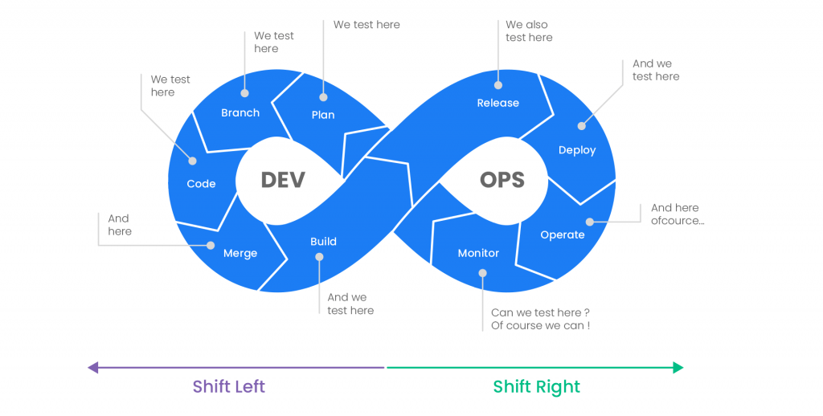

Slide 7
Key take aways
Lead time vs. Processing time Understanding the distinction is crucial for identifying inefficiencies. Optimizing lead time directly impacts customer satisfaction, while improving processing time boosts team productivity. Addressing Deployment Lead Times Traditional deployment lead times of months hinder innovation and responsiveness. Transitioning to deployment lead times of minutes showcases the agility and transformative potential of DevOps practices.
DevOps Practices and Tools Continuous Integration and Continuous Delivery (CI/CD) are pivotal for reducing lead times and maintaining deployment quality. Automation tools, real-time monitoring, and Infrastructure as Code (IaC) enable seamless workflows and faster delivery. Cultural Transformation
DevOps is not just about tools; fostering collaboration between teams and building a culture of continuous improvement is key. Leaders and teams must embrace a learning mindset to sustain the progress of streamlined value streams.

Slide 8
Resources Our lovely book The DevOps Handbook: How to Create World-Class Agility, Reliability, & Security in Technology Organizations, Second Edition by Gene Kim, Jez Humble, Patrick Debois, John Willis, and John Allspaw Lead Time vs. Cycle Time: What’s the Difference? - isixsigma.com Takt Time, Cycle Time, and Lead Time Explained (+ Calculators) How often do you deploy to production? | GoCD Blog Lead Time in DevOps: A Key to Efficient Software Delivery

